Slide 1
Introduction to MAPREDUCE Programming
UNIT -III

Slide 2
CONTENTS
Introduction
Maper
Reducer
Combiner
Partitioner
Searching
Sorting
Compression

Slide 3
CONTD..,
Real time applications using MapReduce
Data serialization
Working with common serialization formats
Big data serialization formats

Slide 4
Introduction
Google released a paper on MapReduce technology in December, 2004.
This became the genesis of the Hadoop Processing Model.
So, MapReduce is a programming model that allows us to perform parallel and distributed processing on huge data sets

Slide 5
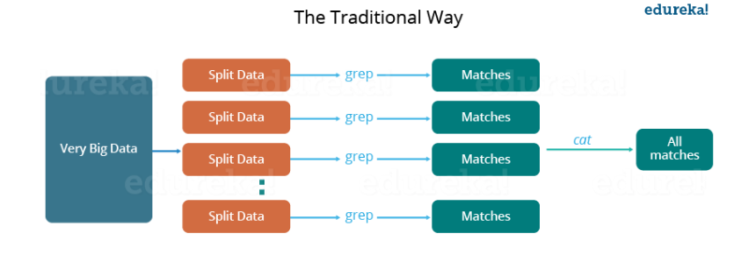

Slide 6
challenges associated with this traditional approach:
Critical path problem: It is the amount of time taken to finish the job without delaying the next milestone or actual completion date. So, if, any of the machines delays the job, the whole work gets delayed.
Reliability problem: What if, any of the machines which is working with a part of data fails? The management of this failover becomes a challenge.
Equal split issue: How will I divide the data into smaller chunks so that each machine gets even part of data to work with. In other words, how to equally divide the data such that no individual machine is overloaded or under utilized.
Single split may fail: If any of the machine fails to provide the output, I will not be able to calculate the result. So, there should be a mechanism to ensure this fault tolerance capability of the system.
Aggregation of result: There should be a mechanism to aggregate the result generated by each of the machines to produce the final output.

Slide 7
Contd..,
To overcome these issues, we have the MapReduce framework which allows us to perform such parallel computations without bothering about the issues like reliability, fault tolerance etc. Therefore, MapReduce gives you the flexibility to write code logic without caring about the design issues of the system.

Slide 8
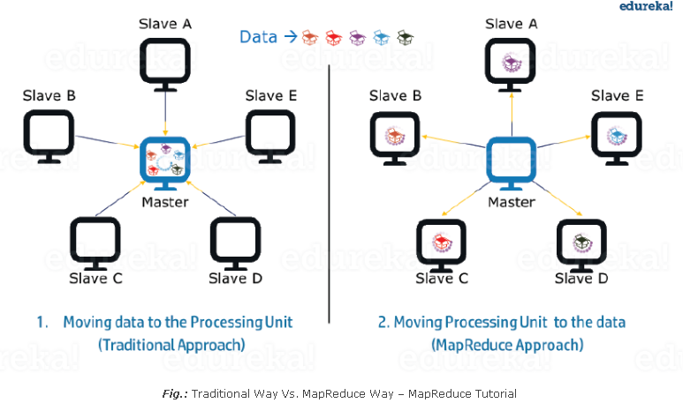
Advantages of MapReduce
1.Parallel Processing:

Slide 9
2. Data Locality:
Instead of moving data to the processing unit, we are moving processing unit to the data in the MapReduce Framework. In the traditional system, we used to bring data to the processing unit and process it. But, as the data grew and became very huge, bringing this huge amount of data to the processing unit posed following issues:
Moving huge data to processing is costly and deteriorates the network performance.
Processing takes time as the data is processed by a single unit which becomes the bottleneck.
Master node can get over-burdened and may fail.
Now, MapReduce allows us to overcome above issues by bringing the processing unit to the data. So, as you can see in the above image that the data is distributed among multiple nodes where each node processes the part of the data residing on it. This allows us to have the following advantages:
It is very cost effective to move processing unit to the data.
The processing time is reduced as all the nodes are working with their part of the data in parallel.
Every node gets a part of the data to process and therefore, there is no chance of a node getting overburdened.

Slide 10
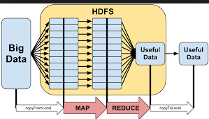

Slide 11
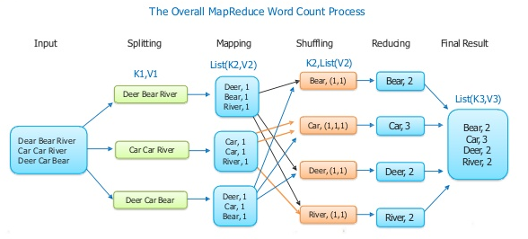

Slide 12
MapReduce Tasks
MapReduce programming splits data into a set of map tasks and reduce tasks
Map task takes care of
Loading
Parsing
Transforming
Filtering
Reduce task takes care of
Grouping
Aggregating the data

Slide 13
MapReduce Phases
Each map task is broken into following phases:
RecordReader: It converts byte oriented view to Record oriented view and giving to the Mapper task. It gives with keys and values. The key is the positional information and value is a chunk of data that constitutes the record.
Map: Map function works on the key-value pair produced by RecordReader and generates zero or more intermediate key-value pairs.

Slide 14
Map Task
Combiner: It is an optional function but provides
high performance in terms of network bandwidth and disk space. It takes intermediate key-value paird provided by mapper and applies user-specific aggregate function to only that mapper output. It is also known as local Reducer.
Partitioner: It takes the intermediate key-value pairs produced by the mapper, splits them into shard, and sends the shard to the particular reducer as per the user-defined condition. The partitioned data of each map task is written to the local disk of that machine and sends to the particular reducer.

Slide 15
Contd..,
Each reduce task is broken into following phases:
Shuffle & Sort:
This phase takes the output of all the partitioners and downloads them onto the local machine, where the Reducer is running. Then these individual data pipes are sorted by keys which produce larger data list.
The individual key-value pairs are sorted by key into a larger data list.
The data list groups the equivalent keys together so that their values can be iterated easily in the Reducer task
Reducer:
The Reducer takes the grouped data produced by the shuffle and sort phase, applies reduce function. key-value paired data as input and runs a Reducer function on each one of them.

Slide 16
Contd..,
Here, the data can be aggregated, filtered, and combined in a number of ways, and it requires a wide range of processing.
Once the execution is over, it gives zero or more key-value pairs to the final step.
Output format:
In the output phase, we have an output formatter that translates the final key-value pairs from the Reducer function and writes them onto a file using a record writer.

Slide 17
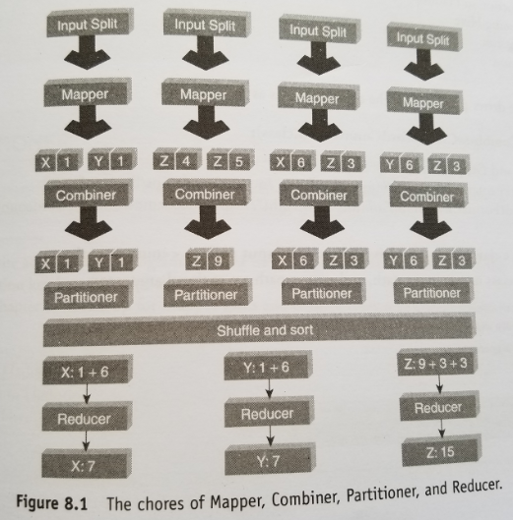

Slide 18
Combiner
Large chunks of intermediate data is generated by the Mapper and this intermediate data is passed on the Reducer for further processing, which leads to enormous network congestion.
MapReduce framework provides a function known as Combiner that plays a key role in reducing network congestion.
“Mini-Reducer” or “Local Reducer” that summarizes the Mapper output record with the same Key before passing to the Reducer

Slide 19
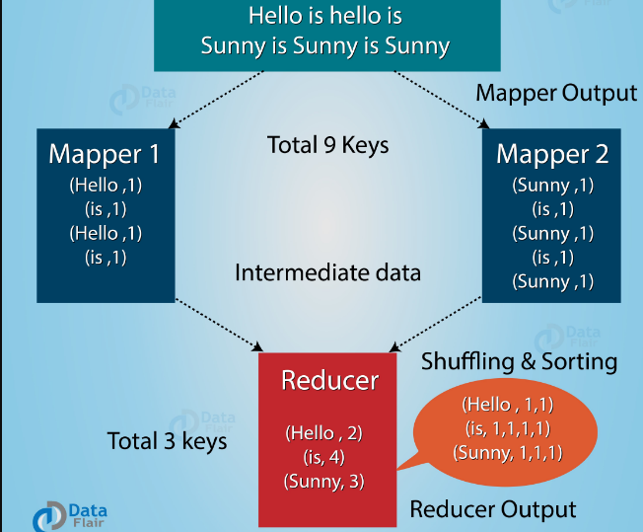
MapReduce program without Combiner

Slide 20
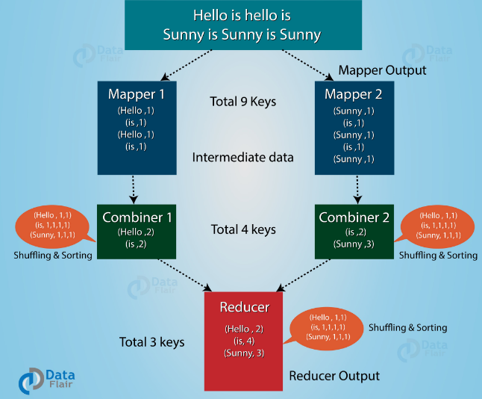
MapReduce program with Combiner

Slide 21
package PackageDemo;
import java.io.IOException;
import org.apache.hadoop.conf.Configuration;
import org.apache.hadoop.fs.Path;
import org.apache.hadoop.io.IntWritable;
import org.apache.hadoop.io.LongWritable;
import org.apache.hadoop.io.Text;
import org.apache.hadoop.mapreduce.Job;
import org.apache.hadoop.mapreduce.Mapper;
import org.apache.hadoop.mapreduce.Reducer;
import org.apache.hadoop.mapreduce.lib.input.FileInputFormat;
import org.apache.hadoop.mapreduce.lib.output.FileOutputFormat;
import org.apache.hadoop.util.GenericOptionsParser;
public class WordCount {
public static void main(String [] args) throws Exception {
Configuration c=new Configuration();
String[] files=new GenericOptionsParser(c,args).getRemainingArgs();
Path input=new Path(files[0]);
Path output=new Path(files[1]);
Job j=new Job(c,"wordcount");
j.setJarByClass(WordCount.class);
j.setMapperClass(MapForWordCount.class);
j.setReducerClass(ReduceForWordCount.class);
j.setCombinerClass(ReduceForWordCount.class);
j.setOutputKeyClass(Text.class);
j.setOutputValueClass(IntWritable.class);
FileInputFormat.addInputPath(j, input);
FileOutputFormat.setOutputPath(j, output);
System.exit(j.waitForCompletion(true)?0:1); }

Slide 22
Map
public static class MapForWordCount extends Mapper<LongWritable,
Text, Text, IntWritable>{
public void map(LongWritable key, Text value, Context con)
throws IOException, InterruptedException
{
String line = value.toString();
String[] words=line.split(“ ");
for(String word: words )
{
Text outputKey = new Text(word.toUpperCase().trim());
IntWritable outputValue = new IntWritable(1);
con.write(outputKey, outputValue);
}
}
}

Slide 23
Reduce
public static class ReduceForWordCount extends Reducer<Text, IntWritable, Text, IntWritable>
{
public void reduce(Text word, Iterable<IntWritable> values,
Context con) throws IOException, InterruptedException
{
int sum = 0;
for(IntWritable value : values)
{
sum += value.get();
}
con.write(word, new IntWritable(sum));
}
}
}

Slide 24
Methods in Mapper Class
protected void cleanup (org.apache.hadoop.mapreduce.Mapper.Context context)
Called once at the end of the task.
protected void map (KEYIN key, VALUEIN value, org.apache.hadoop.mapreduce.Mapper.Context context)
Called once for each key/value pair in the input split.
Void run(org.apache.hadoop.mapreduce.Mapper.Context context)
Expert users can override this method for more complete control over the execution of the Mapper.
protected void setup(org.apache.hadoop.mapreduce.Mapper.Context context)Called once at the beginning of the task.

Slide 25
Methods in reducer
protected void cleanup(org.apache.hadoop.mapreduce.Reducer.Context context)Called once at the end of the task.
protected void reduce(KEYIN key, Iterable<VALUEIN> values, org.apache.hadoop.mapreduce.Reducer.Context context)This method is called once for each key.
Void run(org.apache.hadoop.mapreduce.Reducer.Context context)Advanced application writers can use the run(org.apache.hadoop.mapreduce.Reducer.Context) method to control how the reduce task works.
protected void setup(org.apache.hadoop.mapreduce.Reducer.Context context)Called once at the start of the task.

Slide 26
Partitioner
The Partitioner in MapReduce controls the partitioning of the key of the intermediate mapper output.
By hash function, key (or a subset of the key) is used to derive the partition.
According to the key-value each mapper output is partitioned and records having the same key value go into the same partition (within each mapper), and then each partition is sent to a reducer.
Partition class determines which partition a given (key, value) pair will go.
Partition phase takes place after map phase and before reduce phase.

Slide 27
Partitioner
The partitioning phase happens after map phase and before reduce phase.
The number of partitions are equal to the number of reducers.
The default partitioner is hash partitioner.

Slide 28
Without Partitioner
We want to find the highest paid Female and male employee from the data set. Data Set: Name Age Dept Gender Salary A 23 IT Male 35 B 35 Finance Female 50 C 29 IT Male 40
Considering two map tasks gives following <k,v> as output:
Map1 o/p:
Key Value Gender Value
Male A 23 IT Male 35 Female B 35 Finance Female 50
Map2 o/p Key Value Gender Value
Male C 29 IT Male 40

Slide 29
Custom Partitioner
Our custom partitioner will send all <K,V> by Gender Male to one partition and <K,V> with Female to other partition .
public static class MyPartitioner extends Partitioner<Text,Text>{ public int getPartition(Text key, Text value, int numReduceTasks){ if(numReduceTasks==0) return 0; if(key.equals(new Text("Male")) ) return 0; if(key.equals(new Text("Female"))) return 1; } }

Slide 30
Job.setPartitionerClass(MyPartitioner.class)
job.setNumReduceTasks(2)
part-r-00000 and part-r-00001
It will generate two output files

Slide 31
Custom Partitioner for flights data
public class FlightPartitioner extends Partitioner<Text, Text> { public static int getPartition(Text key, Text value, int numReduceTasks) { if(numReduceTasks==0) { return 0; } if(key.equals(new Text(“JET123”)) { return 0; } else if(key.equals(new Text(“JET545”)) { return 1%numReduceTasks; } else if(key.equals(new Text(“JET789”)) { return 2%numReduceTasks; } else { return 3%numReduceTasks; } } }
In main class
job.setNumReduceTasks(4)

Slide 32
Write a MapReduce program to count the occurrence of similar words in a file by using partitioner.
Import org.apache.hadoop.io.IntWritale;
Import org.apache.hadoop.io.Text;
Import org.apache.hadoop.mapreduce.Partitioner;

Slide 33
Public class WordCountPartitioner extends Partitioner < Text, IntWritable> {
Public int getPartition(Text key, IntWritable value, int numPartitions){
String word=key.toString();
Char alphabet=word.toUpperCase().charAt(0);
Int partitionNumber=0;
Switch(alphabet){
Case ‘A’:partitionNumber=1;break;
Case ‘B’:partitionNumber=2;break;
Case ‘C’:partitionNumber=3;break;
….
Case ‘Z’:partitionNumber=26;break;
Default:partitionNumber=0;break;
}
Return partitionNumber;
}
}

Slide 34
In driver program
Job.setNumReduceTasks(27);
Job.setPartitionerClass(WordCountPartitioner.class);
27 output files are generated by reducers.

Slide 35
Searching
Searching plays an important role in MapReduce algorithm. It helps in the combiner phase (optional) and in the Reducer phase
Example: find out the details of the employee who draws the highest salary in a given employee dataset.

Slide 36
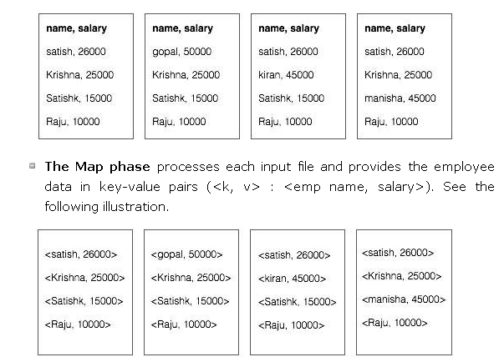

Slide 37
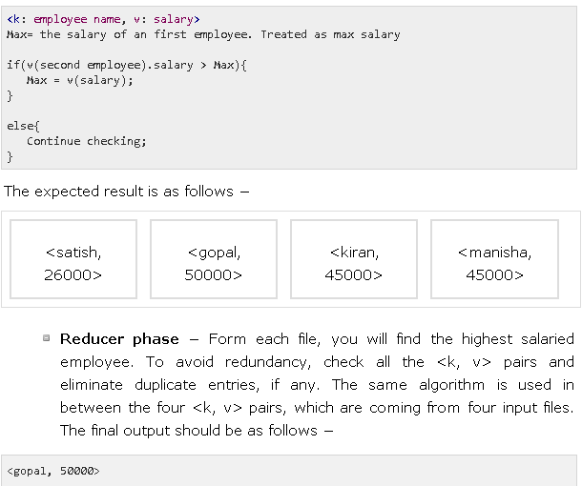
Combiner Phase:
the combiner will check all the employee salary to find the highest salaried employee
in each file

Slide 38
To write a MapReduce program to search for a specific keyword in a file.
1001,john,45
1002,jack,39
1003,Bob,33
Wordsearcher.java
import java.io.IOException;
import org.apache.hadoop.conf.Configuration;
import org.apache.hadoop.fs.Path;
import org.apache.hadoop.io.Text;
import org.apache.hadoop.mapreduce.Job;
import org.apache.hadoop.mapreduce.lib.input.FileInputFormat;
import org.apache.hadoop.mapreduce.lib.input.TextInputFormat;
import org.apache.hadoop.mapreduce.lib.input.FileOutputFormat;
import org.apache.hadoop.mapreduce.lib.input.TextOutputFormat

Slide 39
public class WordSearcher
{
public static void main(String[]args)throws IOException,InterrruptedException,ClassNotFoundException {
Configuration conf = new Configuration();
Job job = new Job(conf);
job.setJarByClass(WordSearcher.class);
job.setOutputKeyClass(Text.class);
job.setOutputValuesClass(Text.class);
job.setMapperClass(WordSearchMapper.class);
job.setReducerClass(WordSearchMapper.class);
job.setInputFormatClass(TextInputFormat.class);
job.setOutputFormatClass(TextOutputFormat.class);
job.setNumReduceTasks(1);
job.getConfiguration().set(“keyword”,”jack”);
FileInputFormat.setInputPaths(job,new Path(“/mapreduce/student.csv”));
FileInputFormat.setOutputPaths(job,new Path(“/mapreduce/output/search”));
System.exit(job.waitForCompletion(true)? 0 :1); } }

Slide 40
wordSearchMapper.java
Public class WordSearchMapper extends Mapper<LongWritable, Text,Text,Text>{
Static String keyword;
Static int pos=0;
Protected void setup(Context con) throws IOException,InterruptedException {
Configuration config=con.getConfiguration();
Keyword=config.get(“keyword”
}

Slide 41
Protected voif map(LongWritable key, Text value,
Context con) throws IOException,InterruptedException {
InputSplit i=context.getInputSplit();
FileSplit f=(FileSplit) I;
String fileName=f.getPath().getName();
pos++;
If(value.toString().contains(keywrod){
wordPos=value.find(keyword);
Con.write(value,new Text(fileName+” , “ + new IntWritable(pos).toString()+”,”+wordPos.toString()));
}
}
}

Slide 42
Import java.io.IOException;
Import org.apache.hadoop.io.Text;
Import org.apache.hadoop.mapreduce.Reducer;
Public class wordsearchReducer extends Reducer<Text, Text,Text, Text> {
Protected void reduce(Text key,Text value, Context con) throws IOException, InterruptedException{
Context.write(key,value);
}
}
Output
1002,jack,39 emp.csv,2,5

Slide 43
Sorting
Sorting is one of the basic MapReduce algorithms to process and analyze data. MapReduce implements sorting algorithm to automatically sort the output key-value pairs from the mapper by their keys. Sorting methods are implemented in the mapper class itself.
In the Shuffle and Sort phase, after tokenizing the values in the mapper class, the Context class (user-defined class) collects the matching valued keys as a collection.
To collect similar key-value pairs (intermediate keys), the Mapper class takes the help of RawComparator class to sort the key-value pairs.
The set of intermediate key-value pairs for a given Reducer is automatically sorted by Hadoop to form key-values (K2, {V2, V2, …}) before they are presented to the Reducer.

Slide 44
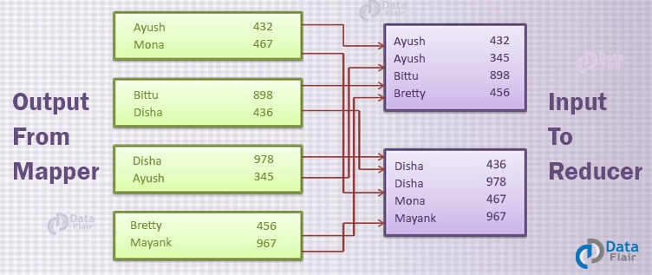

Slide 45
SortMapper.java
Public class SortMapper extends Mapper<LongWritable, Text,Text,Text>{
Protected voif map(LongWritable key, Text value,
Context con) throws IOException,InterruptedException {
String [] token=value.toString().Split(“,”); Con.write(new Text(token[1]), new Text(token[0]+” –”+token[1]));
}
}

Slide 46
Public class sortReducer extends Reducer<Text, Text,Text, Text> {
Protected void reduce(Text key,Iterable<Text> values, Context con) throws IOException, InterruptedException{
for(Text details:values)
{
Context.write(NullWritable.get(),details);
}
}

Slide 47
Compression
In map reduce program you can compress the MapReduce output file. Compression provides two benefits as follows:
Reduces the space to store files
Speeds up data transfer across the network
You can specify compression format in the Driver program as shown below
Conf.setBoolean(“mapred.output.compress”, true);
Conf.setClass(“mapred.output.compression.codec”,GzipCodec.class,CompressionCodec.class);

Slide 48
Real time applications using MapReduce
Social networks
Media and Entertainment
Health Care
Business
Banking
Stock Market
Weather Forecasting

Slide 49
Data serialization
serialization is the process of translating data structures or object state into a format that can be stored (for example, in a file or memory buffer) or transmitted (for example, across a network connection link) and reconstructed later.
Data Serialization is the process of converting object data into byte stream data for transmission over a network across different nodes in a cluster or for persistent data storage.
MapReduce offers straightforward, well-documented support for working with simple data formats such as log files.
But the use of MapReduce has evolved beyond log files to more sophisticated data serialization formats—such as text, XML, and JSON—to the point that its documentation and built-in support runs dry.

Slide 50
Working with XML and JSON in MapReduce, however, poses two equally important challenges.
1. Though MapReduce requires classes that can support reading and writing a particular data serialization format, there’s a good chance it doesn’t have such classes to support the serialization format you’re working with.
2.MapReduce’s power lies in its ability to parallelize reading your input data. If your input files are large (think hundreds of megabytes or more), it’s crucial that the classes reading your serialization format be able to split your large files so multiple map tasks can read them in parallel.
Data serialization support in MapReduce is a property of the input and output classes that read and write MapReduce data

Slide 51
JSON( JavaScript Object Notation)
{ "firstName": "John", "lastName": "Smith", "isAlive": true, "age": 27, "address": { "streetAddress": "21 2nd Street", "city": "New York", "state": "NY", "postalCode": "10021-3100" }, "phoneNumbers": [ { "type": "home", "number": "212 555-1234" }, { "type": "office", "number": "646 555-4567" }, { "type": "mobile", "number": "123 456-7890" } ], "children": [], "spouse": null }

Slide 52
Working with common serialization formats
XML and JSON are industry-standard data interchange formats. Their ubiquity in the technology industry is evidenced by their heavy adoption in data storage and exchange.
XML
XML has existed since 1998 as a mechanism to represent data that’s readable by machine and human alike. It became a universal language for data exchange between systems. It’s employed by many standards today such as SOAP and RSS, and used as an open data format for products such as Microsoft Office.

Slide 53
Contd..,
MapReduce and XML
While MapReduce comes bundled with an InputFormat that works with text, it doesn’t come with one that supports XML. Working on a single XML file in parallel in MapReduce is tricky because XML doesn’t contain a synchronization marker in its data format.
Problem To work with large XML files in MapReduce and be able to split and process them in parallel.
Solution Mahout’s XMLInputFormat can be used to work with XML files in HDFS with MapReduce. It reads records that are delimited by a specific XML begin and end tag. This technique also covers how XML can be emitted as output in MapReduce output.

Slide 54
JSON
JSON shares the machine- and human-readable traits of XML, and has existed since the early 2000s. It’s less verbose than XML, and doesn’t have the rich typing and validation features available in XML.
MapReduce and JSON Imagine you have some code that’s downloading JSON data from a streaming REST service and every hour writes a file into HDFS. The data amount that’s being downloaded is large, so each file being produced is multiple gigabytes in size. You’ve been asked to write a MapReduce job that can take as input these large JSON files.
What you have here is a problem in two parts: first, MapReduce doesn’t come with an InputFormat that works with JSON. Second, how does one even go about splitting JSON? To split files, given a random offset in a file, you’ll need to be able to determine the start of the next JSON element. This is made more challenging when working with JSON because it’s a hierarchical data format and the same element name can be used in multiple levels, as shown in the figure. JSON is harder to partition into distinct segments than a format such as XML because JSON doesn’t have a token (like an end tag in XML) to denote the start or end of a record.

Slide 55
Big data serialization formats
Unstructured text works well when you’re working with scalar or tabular data.
Semi structured text formats such as XML and JSON can model more sophisticated data structures that include composite fields, or hierarchical data.
But when you’re working with big data volumes you’ll need serialization formats with compact serialized forms that natively support partitioning and have schema evolution features.

Slide 56
Comparing SequenceFiles, Protocol Buffers, Thrift, and Avro It’s important to make certain considerations when choosing a file format. Important characteristics for big data serialization:
■ Code generation—The ability to generate Java classes and utilities that can be used for serialization and deserialization.
■ Versioning—The ability for the file format to support backward or forward compatibility.
■ Language support—The programming languages supported by the library.
■ Transparent compression—The ability for the file format to handle compressing records internally.
■ Splittability—The ability of the file format to support multiple input splits.
■ Native support in MapReduce—The input/output formats that support reading and writing files in their native format (that is, produced directly from the data format library).
■ Pig and Hive support—The Pig Store and Load Functions (referred to as Funcs) and Hive SerDe classes to support the data format.

Slide 57
